Slide 1
Segmenting Hotel Customers Based on Cluster Analysis
Team Members: (Group 3)
1. Bavatharani V
2. Prasanna Vignesh H
3. Meena S
4. Anand Balaje P
5. Sai Sidhartha H
Mentored by:
Ankush Bansal

Slide 2
Problem Statement
Domain - Hospitality Industry
Business problem statement – Customer Segmentation in Hospitality Industry
A hotel’s ideal goal must be to provide the finest facilities and services in the market while providing a good work place for its employees and a reasonable return for the investments by its owners.
Customer Segmentation process in Hotel industry helps to improve the revenue of the business and allows business people to understand their customers.
Why we do Cluster Analysis:
To understand the customers expectations.
Increasing the business revenue and providing right recommendations to customers

Slide 3
DATASET
The dataset is collected from a research paper which describes a hotel customer dataset with 31 variables describing a total of instances (customers).
It comprehends three full years of customer behavioral data. .
In addition to personal and behavioral information, the dataset also contains demographic and geographical information. Due to its unit of analysis, it is a dataset especially suitable for building customer segmentation models, including clustering and RFM (Recency, Frequency, and Monetary value) models, but also be used in classification and regression problems
The collected data is between 2015 and 2018.
Rows : 83,590 , Columns : 31
The reason we chose this dataset is understand the customers behavior and segment them into groups which in turn helps the market people

Slide 4
DATA DICTIONARY
Numerical Columns : 12 , Categorical columns : 5, Boolean Columns: 13
Categorical Columns | Numerical Columns |  | Boolean Column
Nationality | Age | BookingsCheckedIn | SRHighFloor | SRLowFloor
NameHash | DaysSinceCreation | PersonsNights | SRAccessibleRoom | SRMediumFloor
DocIDHash | AverageLeadTime | RoomNights | SRBathtub | SRShower
DistributionChannel | LodgingRevenue | DaysSinceLastStay | SRCrib | SRKingSizeBed
MarketSegment | OtherRevenue | DaysSinceFirstStay | SRTwinBed | SRNearElevator
 | BookingsCanceled | BookingsNoShowed | SRAwayFromElevato | SRNoAlcoholInMiniBar
 |  |  | SRQuietRoom

Slide 5
Data Cleaning and Preprocessing
Null value imputation(only Age variable has 4% null variables, it’s been imputed using mode.)
Data cleaning:
In our dataset, around 19920 instances have no information on all variables. Removing those instances does not affect the model, so those instances are removed.
Feature Transformation:
Nationality:
Nationality variables are having 188 unique categories, to reduce the levels the countries are converted into 7 continents.
Amenities:
Boolean variables like SRHighFloor, SRLowFloor, SRAccessibleRoom, SRMediumFloor, SRBathtub, SRShower, SRCrib, SRKingSizeBed, SRTwinBed, SRNearElevator, SRAwayFromElevato, SRNoAlcoholInMiniBar, SRQuietRoom represents the preference of the customer, combining all columns implies whether the customer has opted for any special requests and gives much more information than the variables. The Boolean variables combined into a single variable named Amenties.

Slide 6
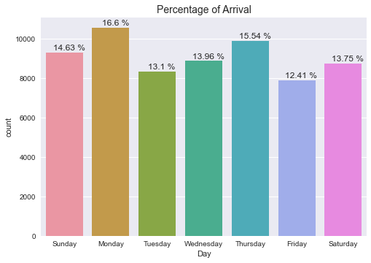
EDA
Accommodations
 | Total Bookings | Bookings Checked In (confirmed bookings) | Bookings Canceled | Bookings Not showed (Canceled nor checked in)
Bookings | 66644 | 66422 | 136 | 53
% Rate | - | 99.6 % | 0.25 % | 0.07 %
Cancelation Rate
/ Market Segment

Slide 7
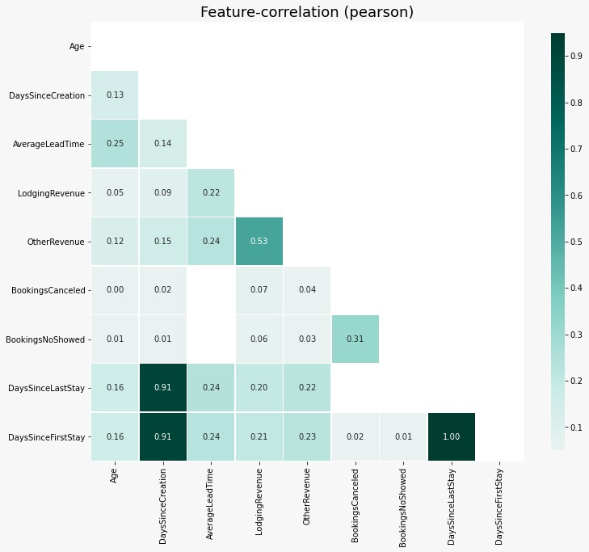
CORRELATION
Feature 1 | Feature 2 | Correlation
DaysSincelaststay | Daysincecreation | 0.91
Dayssincefirststay | Daysincecreation | 0.91
Dayssincefirststay | DaysSincelaststay | 1.00

Slide 8
Statistical significance of variables
Features | Null Hypothesis | Alternate Hypothesis | Significance level | P-Value | Statistical Test
Amenities & Age | Customer's preference for amenities are independent of their ages | Customer's preference for amenities are dependent of their ages | 5% | 0.42 | Chi2-Contingency
Nationality & Distribution Channel | Nationality of customers are independent of Distribution Channel | Nationality of customers are dependent of Distribution Channel | 5% | 0.28 | Chi2-Contingency

Slide 9
Feature Engineering
We have clubbed all the Boolean variable columns into a single column as amenities by adding all the special requests raised by the customers. And we get to see that maximum of four special requests has been requested from a single customer.
Scaling the data:
To make it much easier for the model to learn the information from the data, we scale the data using the StandardScaler object from the Sklearn library. The StandardScaler is first to fit with the train data. This helps the StandardScaler object to learn the statistical data of the train data. Then we transform the train data with the StandardScaler object. Then with the same object, the test data is also transformed, so that the test data is transformed with the same statistics of the train data.

Slide 10
Unsupervised Machine Learning Models
USL Models used in this project for the mentioned dataset are:
K-Means
K-Prototype
DBSCAN
Agglomerative Clustering
Expectation Maximization

Slide 11
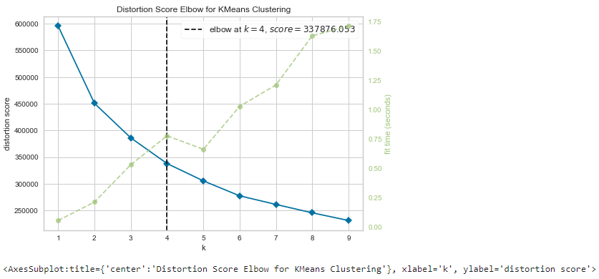
Optimal Values of K using Elbow Method
From the Elbow Graph we can infer that optimal value of k = 4.

Slide 12
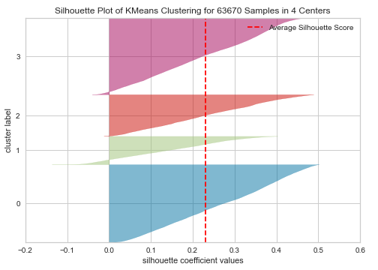
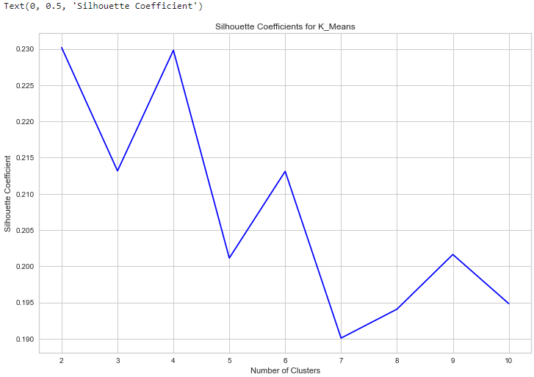
Optimal Values of K using Silhouette Coefficeints
From the Elbow Graph we can infer that optimal value of k = 4.

Slide 13
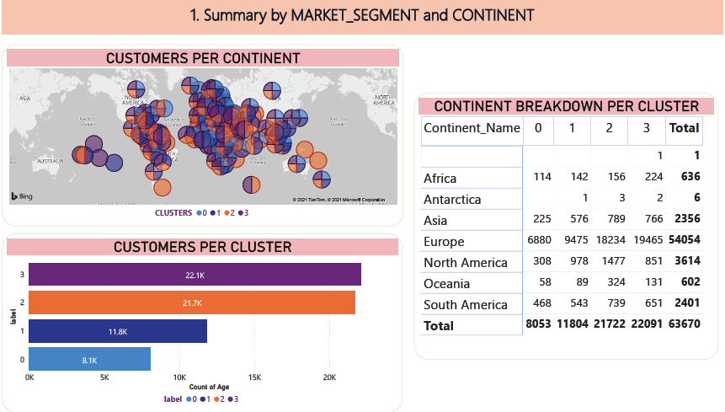
Cluster Visualization

Slide 14
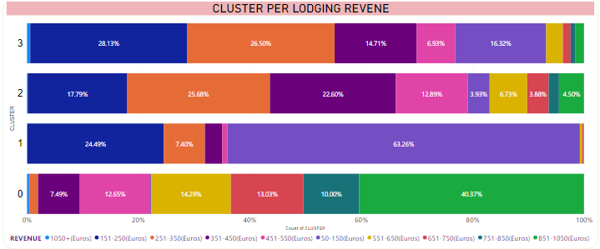
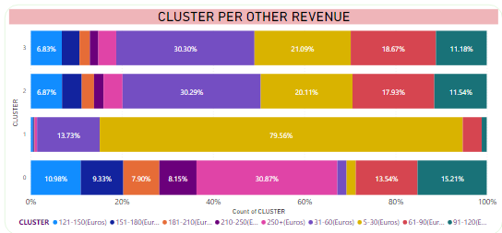

Slide 15
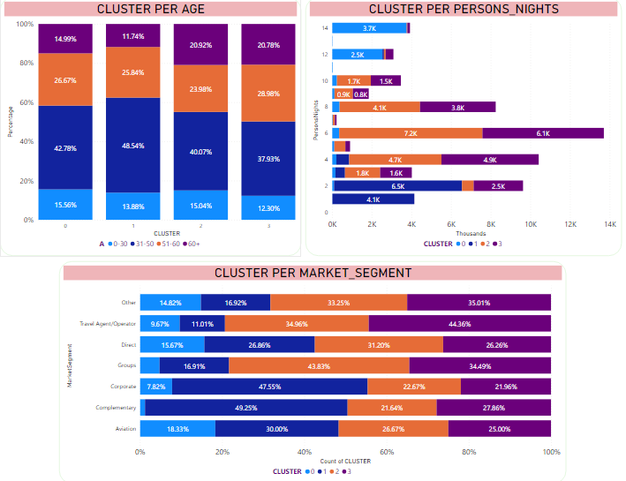

Slide 16
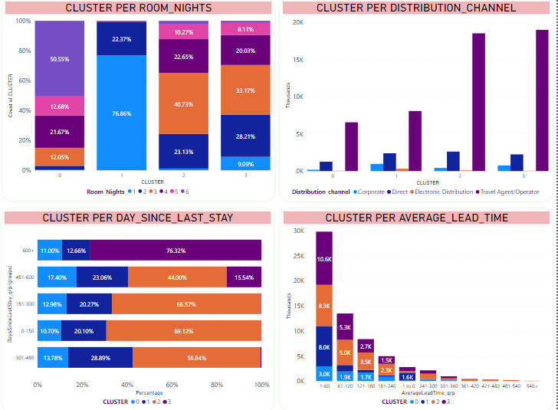

Slide 17
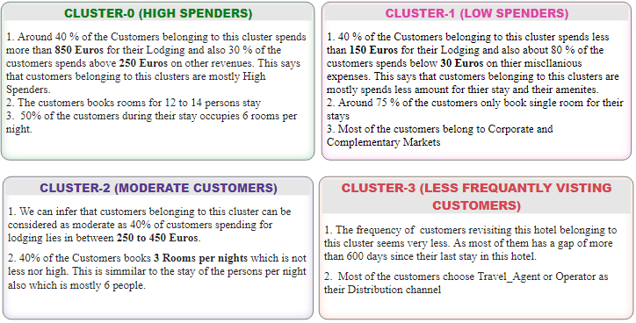
CLUSTER TRAITS

Slide 18
THANK YOU

